Slide 1
COSC 3100 Divide and Conquer
Instructor: Tanvir

Slide 2
What is Divide and Conquer ?
3rd algorithm design technique, we are going to study
Very important: two out of ten most influential algorithms in the twentieth century is based directly on “Divide and Conquer” technique
Quicksort (we shall study today)
Fast Fourier Transform (we shall not study in this course, but any “signal processing” course is based on this idea)

Slide 3
Divide and Conquer
Three steps are involved:
Divide the problem into several subproblems, perhaps of equal size
Subproblems are solved, typically recursively
The solutions to the subproblems are combined to get a solution to the original problem
Real work is done in 3 different places: in partitioning; at the very tail end
of the recursion, when subproblems are so small that they are solved directly;
and in gluing together of partial solutions

Slide 4
Divide and Conquer (contd.)
Problem of size n
Subproblem 1 of size n/2
Subproblem 2 of size n/2
Don’t assume
always breaks up
into 2, could be > 2
subproblems
Solution to subproblem 1
Solution to subproblem 2
Solution to the original probelm

Slide 5
Divide and Conquer (contd.)
In “politics” divide and rule (latin: divide et impera) is a combination of political, military, and economic strategy of gaining and maintaining power by breaking up larger concentrations of power into chunks that individually have less power than the one who is implementing the strategy. (read more on wiki: “Divide and rule”)

Slide 6
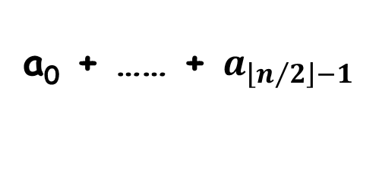
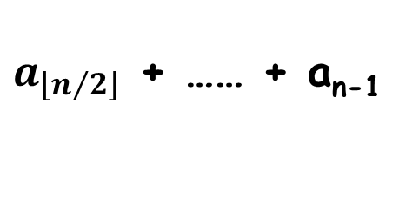
Divide and Conquer (contd.)
Let us add n numbers using divide and conquer technique
a₀ + a₁ + …… + a_{n-1}
a₀ + …… + $a_{\left\lfloor n/2\right\rfloor −1}$
$a_{\left\lfloor n/2\right\rfloor }$ + …… + a_{n-1}
Is it more efficient than brute force ?
Let’s see with an example

Slide 7
Div. & Conq. (add n numbers)
0 | 1 | 2 | 3 | 4 | 5 | 6 | 7 | 8 | 9
2 | 10 | 3 | 5 | 7 | 1 | 6 | 10 | 1 | 3
0 | 1 | 2 | 3 | 4
0 | 1 | 2 | 3 | 4
2 | 10 | 3 | 5 | 7
1 | 6 | 10 | 1 | 3
# of additions
is same as in
brute force,
needs stack
for recursion…
2 | 10
3 | 5 | 7
1 | 6
10 | 1 | 3
12
3
5 | 7
7
10
1 | 3
Bad!
not all divide
and conquer
works!!
12
4
15
14
27
21
Could be efficient
for parallel processors though….
48

Slide 8
Div. & Conq. (contd.)
Usually in div. & conq., a problem instance of size n is divided into two instances of size n/2
More generally, an instance of size n can be divided into b instances of size n/b, with a of them needing to be solved
Assuming that n is a power of b (n = b^{m}), we get
T(n) = aT(n/b) + f(n)
Here, f(n) accounts for the time spent in dividing an instance of size n into subproblems of size n/b and combining their solution
For adding n numbers, a = b = 2 and f(n) = 1
general divide-and-conquer
recurrence

Slide 9
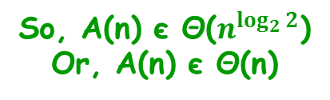
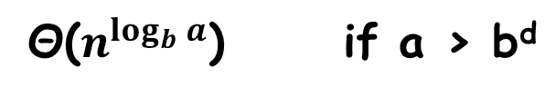
Div & Conq. (contd.)
T(n) = aT(n/b)+f(n), a ≥ 1, b > 1
Master Theorem:
If f(n) є Θ(n^{d}) where d ≥ 0 then
What if a = 1?
Have we seen it?
Θ(n^{d}) if a < b^{d}
So, A(n) є Θ($n^{\log_{2}{2}}$)
Or, A(n) є Θ(n)
T(n) є
Θ(n^{d}lgn) if a = b^{d}
Without going through
back-subs. we got it,
but not quite…
Θ($n^{\log_{b}{a}}$) if a > b^{d}
For adding n numbers with divide and conquer technique, the number
of additions A(n) is:
A(n) = 2A(n/2)+1
Here, a = ?, b = ?, d = ?
a = 2, b = 2, d = 0
Which of the 3 cases holds ?
a = 2 > b^{d} = 2⁰, case 3

Slide 10
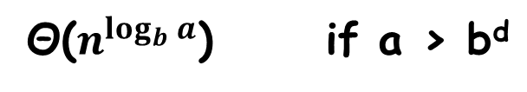


Div. & Conq. (contd.)
T(n) = aT(n/b)+f(n), a ≥ 1, b > 1
If f(n) є Θ(n^{d}) where d ≥ 0, then
Θ(n^{d}) if a < b^{d}
T(n) є
Θ(n^{d}lgn) if a = b^{d}
T(n) = 2T(n/2)+6n-1?
Θ($n^{\log_{b}{a}}$) if a > b^{d}
T(n) = 3 T(n/2) + n
a = 3, b = 2, f(n) є Θ(n¹), so d = 1
a=3 > b^{d}=2¹
Case 3: T(n) є Θ( $n^{\log_{2}{3}}$ ) = Θ( $n^{1.5850}$ )
T(n) = 3 T(n/2) + n²
a = 3, b = 2, f(n) є Θ(n²), so d = 2
a=3 < b^{d}=2²
Case 1: T(n) є Θ( $n^{2}$ )
T(n) = 4 T(n/2) + n²
a = 4, b = 2, f(n) є Θ(n²), so d = 2
a=4 = b^{d}=2²
Case 2: T(n) є Θ( $n^{2}$lgn )
T(n) = 0.5 T(n/2) + 1/n
Master th^{m} doesn’t apply,a<1, d<0
T(n) = 2 T(n/2) + n/lgn
Master th^{m} doesn’t apply f(n) not polynomial
T(n) = 64 T(n/8) – n²lgn
f(n) is not positive, doesn’t apply
T(n) = 2^{n} T(n/8) + n
a is not constant, doesn’t apply

Slide 11
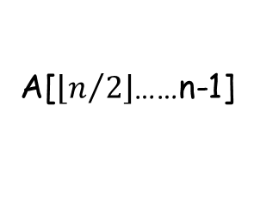
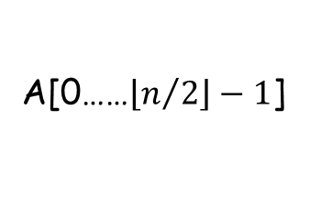
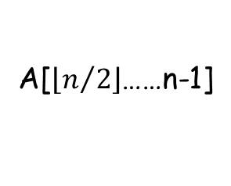
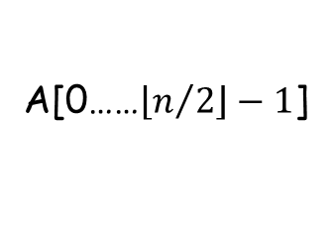
Div. & Conq.: Mergesort
Sort an array A[0..n-1]
A[0……n-1]
divide
A[0……$\left\lfloor n/2\right\rfloor −1$]
A[$\left\lfloor n/2\right\rfloor$……n-1]
sort
sort
A[0……$\left\lfloor n/2\right\rfloor −1$]
A[$\left\lfloor n/2\right\rfloor$……n-1]
merge
A[0……n-1]
Go on dividing recursively…

Slide 12
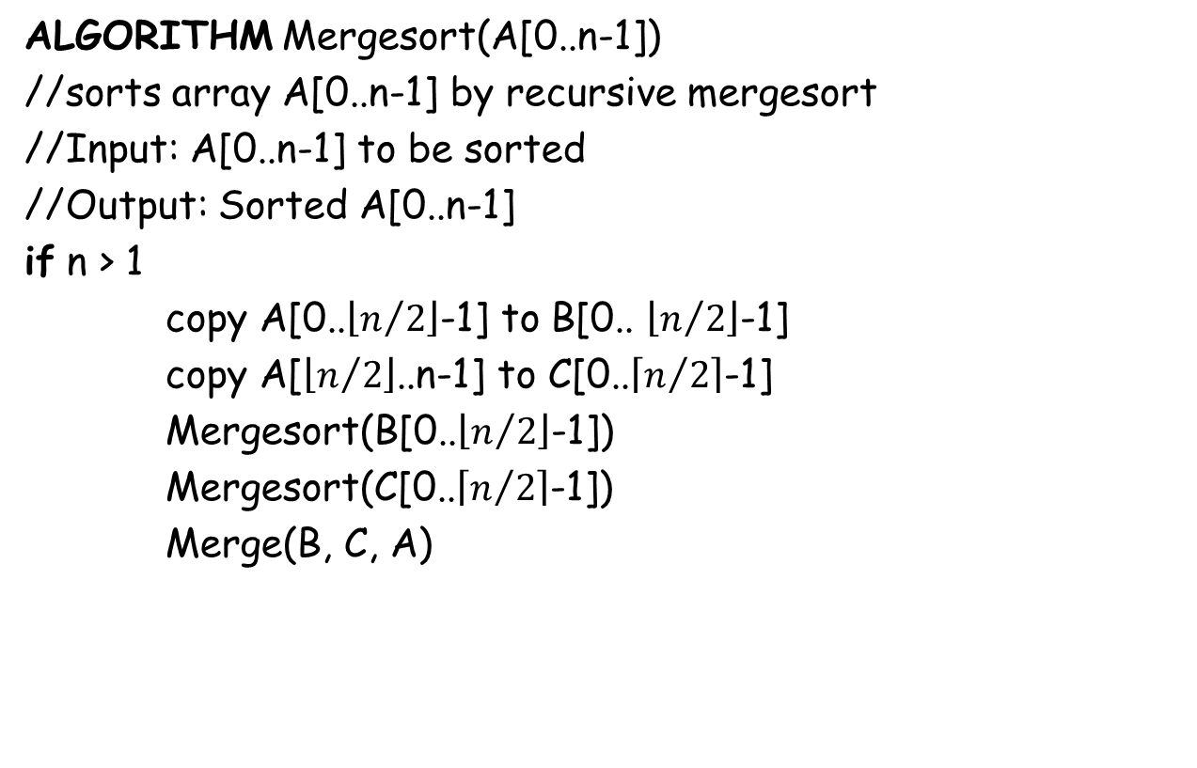
Div. & Conq.: Mergesort(contd.)
ALGORITHM Mergesort(A[0..n-1])
//sorts array A[0..n-1] by recursive mergesort
//Input: A[0..n-1] to be sorted
//Output: Sorted A[0..n-1]
if n > 1
copy A[0..$\left\lfloor n/2\right\rfloor$-1] to B[0.. $\left\lfloor n/2\right\rfloor$-1]
copy A[$\left\lfloor n/2\right\rfloor$..n-1] to C[0..$\left\lceil n/2\right\rceil$-1]
Mergesort(B[0..$\left\lfloor n/2\right\rfloor$-1])
Mergesort(C[0..$\left\lceil n/2\right\rceil$-1])
Merge(B, C, A)
B:
2 | 3 | 8 | 9
C:
1 | 4 | 5 | 7
A:
1
2
3
4
5
7
8
9

Slide 13
Div. & Conq.: Mergesort(contd.)
ALGORITHM Merge(B[0..p-1], C[0..q-1], A[0..p+q-1])
//Merges two sorted arrays into one sorted array
//Input: Arrays B[0..p-1] and C[0..q-1] both sorted
//Output: Sorted array A[0..p+q-1] of elements of B and C
i <- 0; j <- 0; k <- 0;
while i < p and j < q do
if B[i] ≤ C[j]
A[k] <- B[i]; i <- i+1
else
A[k] <- C[j]; j <- j+1
k <- k+1
if i = p
copy C[j..q-1] to A[k..p+q-1]
else
copy B[i..p-1] to A[k..p+q-1]

Slide 14
Div. & Conq.: Mergesort(contd.)
Divide:
8 | 3 | 2 | 9 | 7 | 1 | 5 | 4
Merge:
8 | 3 | 2 | 9
7 | 1 | 5 | 4
8 | 3
2 | 9
7 | 1
5 | 4
8
3
2
9
7
1
5
4
3 | 8
2 | 9
1 | 7
4 | 5
2 | 3 | 8 | 9
1 | 4 | 5 | 7
1 | 2 | 3 | 4 | 5 | 7 | 8 | 9

Slide 15
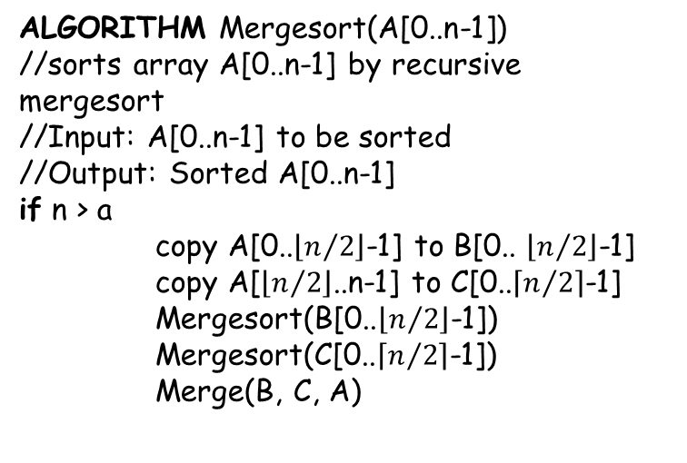
Div. & Conq.: Mergesort(contd.)
ALGORITHM Mergesort(A[0..n-1])
//sorts array A[0..n-1] by recursive mergesort
//Input: A[0..n-1] to be sorted
//Output: Sorted A[0..n-1]
if n > a
copy A[0..$\left\lfloor n/2\right\rfloor$-1] to B[0.. $\left\lfloor n/2\right\rfloor$-1]
copy A[$\left\lfloor n/2\right\rfloor$..n-1] to C[0..$\left\lceil n/2\right\rceil$-1]
Mergesort(B[0..$\left\lfloor n/2\right\rfloor$-1])
Mergesort(C[0..$\left\lceil n/2\right\rceil$-1])
Merge(B, C, A)
ALGORITHM Merge(B[0..p-1], C[0..q-1], A[0..p+q-1])
//Merges two sorted arrays into one sorted array
//Input: Arrays B[0..p-1] and C[0..q-1] both sorted
//Output: Sorted array A[0..p+q-1] of elements of B //and C
i <- 0; j <- 0; k <- 0;
while i < p and j < q do
if B[i] ≤ C[j]
A[k] <- B[i]; i <- i+1
else
A[k] <- C[j]; j <- j+1
k <- k+1
if i = p
copy C[j..q-1] to A[k..p+q-1]
else
copy B[i..p-1] to A[k..p+q-1]
What is the time-efficiency
of Meresort?
Input size: n = 2^{m}
Basic op: comparison
C(n) depends on input
type…
C(n) = 2C(n/2) + C_{Merge}(n) for n > 1,
C(1) = 0
C_{worst}(n) = 2C_{worst}(n/2)+n-1 for n > 1
C_{worst}(1) = 0
B:
2 | 5 | 8
C:
3 | 4 | 9
In worst-case
C_{Merge}(n) = n-1
A:
2 | 3 | 4 | 5 | 8 | 9
C_{worst}(n) = nlgn-n+1 є Θ(nlgn)
How many comparisons
is needed for this Merge?
Could use the master th^{m} too!

Slide 16
Div. & Conq.: Mergesort(contd.)
Worst-case of Mergesort is Θ(nlgn)
Average-case is also Θ(nlgn)
It is stable but quicksort and heapsort are not
Possible improvements
Implement bottom-up. Merge pairs of elements, merge the sorted pairs, so on… (does not require recursion-stack anymore)
Could divide into more than two parts, particularly useful for sorting large files that cannot be loaded into main memory at once: this version is called “multiway mergesort”
Not in-place, needs linear amount of extra memory
Though we could make it in-place, adds a bit more “complexity” to the algorithm

Slide 17
Div. & Conq.: Quicksort
Another divide and conquer based sorting algorithm, discovered by C. A. R. Hoare (British) in 1960 while trying to sort words for a machine translation project from Russian to English
Instead of “Merge” in Mergesort, Quicksort uses the idea of partitioning which we already have seen with “Lomuto Partition”

Slide 18
Div. & Conqr.: Quicksort (contd.)
A[0]…A[n-1]
A[0]…A[s-1] A[s] A[s+1]…A[n-1]
all are ≤ A[s]
all are ≥ A[s]
Notice:
In Mergesort
all work is in
combining the
partial solutions.
In Quicksort all
work is in dividing
the problem,
Combining does not require any work!
A[s] is in it’s
final position
Now continue working with
these two parts

Slide 19
Div. & Conqr.: Quicksort (contd.)
ALGORITHM Quicksort(A[l..r])
//Sorts a subarray by quicksort
//Input: Subarray of array A[0..n-1] defined by its //left and right indices l and r
//Output: Subarray A[l..r] sorted in nondecreasing //order
if l < r
s <- Partition( A[l..r] ) // s is a split position
Quicksort( A[l..s-1] )
Quicksort( A[s+1]..r )

Slide 20
Div. & Conqr.: Quicksort (contd.)
As a partition algorithm we could use “Lomuto Partition”
But we shall use the more sophisticated “Hoare Partition” instead
We start by selecting a “pivot”
There are various strategies to select the pivot, we shall use the simplest: we shall select pivot, p =A[l], the first element of A[l..r]

Slide 21
Div. & Conqr.: Quicksort (contd.)
p
≤ p
p
≥ p
i
j
p
If A[i] < p, we continue incrementing i, stop when A[i] ≥ p
If A[j] > p, we continue decrementing j, stop when A[j] ≤ p
i
j
p
all ≤ p
≥ p
≤ p
all ≥ p
j
i
p
all ≤ p
≤ p
≥ p
all ≥ p
j=i
p
all ≤ p
= p
all ≥ p

Slide 22
Div. & Conqr.: Quicksort (contd.)
ALGORITHM HoarePartition(A[l..r])
//Output: the split position
p <- A[l]
i <- l; j <- r+1
repeat
repeat i <- i+1 until A[i] ≥ p
repeat j <- j-1 until A[j] ≤ p
swap( A[i], A[j] )
until i ≥ j
swap( A[i], A[j] ) // undo last swap when i ≥ j
swap( A[l], A[j] )
return j
i could go out of array’s
bound, we could check
or we could put a “sentinel”
at the end…
Do you see any
possible problem
with this pseudocode ?
More sophisticated pivot selection
that we shall see briefly makes this
“sentinel” unnecessary…

Slide 23
Div. & Conqr.: Quicksort (contd.)
i
j
i
j
5 | 3 | 1 | 9 | 8 | 2 | 4 | 7
2 | 3 | 1 | 4 | 5 | 8 | 9 | 7
i
j
i
j
5 | 3 | 1 | 9 | 8 | 2 | 4 | 7
2 | 3 | 1 | 4 | 5 | 8 | 9 | 7
1 | 2 | 3 | 4 | 5 | 8 | 9 | 7
i
j
i
j
i
j
5 | 3 | 1 | 4 | 8 | 2 | 9 | 7
2 | 1 | 3 | 4 | 5 | 8 | 9 | 7
1 | 2 | 3 | 4 | 5 | 8 | 9 | 7
i
j
j
i
i
j
5 | 3 | 1 | 4 | 8 | 2 | 9 | 7
2 | 1 | 3 | 4 | 5 | 8 | 9 | 7
1 | 2 | 3 | 4 | 5 | 8 | 7 | 9
i
j
j
i
5 | 3 | 1 | 4 | 2 | 8 | 9 | 7
1 | 2 | 3 | 4 | 5 | 8 | 9 | 7
1 | 2 | 3 | 4 | 5 | 8 | 7 | 9
j
i
5 | 3 | 1 | 4 | 2 | 8 | 9 | 7
1 | 2 | 3 | 4 | 5 | 8 | 9 | 7
1 | 2 | 3 | 4 | 5 | 7 | 8 | 9
i=j
2 | 3 | 1 | 4 | 5 | 8 | 9 | 7
1 | 2 | 3 | 4 | 5 | 8 | 9 | 7
1 | 2 | 3 | 4 | 5 | 7 | 8 | 9
j
i
1 | 2 | 3 | 4 | 5 | 8 | 9 | 7
1 | 2 | 3 | 4 | 5 | 7 | 8 | 9

Slide 24
Div. & Conqr.: Quicksort (contd.)
0 | 1 | 2 | 3 | 4 | 5 | 6 | 7
5 | 3 | 1 | 9 | 8 | 2 | 4 | 7
0 | 1 | 2 | 3 | 4 | 5 | 6 | 7
5 | 3 | 1 | 9 | 8 | 2 | 4 | 7
l=0,r=7
0 | 1 | 2 | 3 | 4 | 5 | 6 | 7
s=4
2 | 3 | 1 | 4 | 5 | 8 | 9 | 7
l=0,r=3
l=5,r=7
s=1
s=6
0 | 1 | 2 | 3
5 | 6 | 7
1 | 2 | 3 | 4
7 | 8 | 9
l=0,r=0
l=2,r=3
l=5,r=5
l=7,r=7
s=2
5
0
l=2,r=1
l=3,r=3
1
7
2 | 3
7
3 | 4
9
3
4

Slide 25
Div. & Conqr.: Quicksort (contd.)
Let us analyze Quicksort
ALGORITHM Quicksort(A[l..r])
if l < r
s <- HoarePartition ( A[l..r] )
Quicksort( A[l..s-1] )
Quicksort( A[s+1]..r )
Time-complexity of this line ?
i
j
So, n+1
comparisons
when cross-over
5 | 3 | 1 | 4 | 8 | 2 | 9 | 7
i
j
5 | 3 | 1 | 4 | 2 | 8 | 9 | 7
If all splits
happen in the
middle, it is
the best-case!
j
i
ALGORITHM HoarePartition(A[l..r])
//Output: the split position
p <- A[l]
i <- l; j <- r+1
repeat
repeat i <- i+1 until A[i] ≥ p
repeat j <- j-1 until A[j] ≤ p
swap( A[i], A[j] )
until i ≥ j
swap( A[i], A[j] ) // undo last swap when i ≥ j
swap( A[l], A[j] )
return j
5 | 3 | 1 | 4 | 2 | 8 | 9 | 7
So, n
comparisons
when coincide
What if,
i,j
5 | 3 | 1 | 4 | 5 | 8 | 9 | 7
C_{best}(n) = 2C_{best}(n/2)+n for n > 1
C_{best}(1) = 0

Slide 26
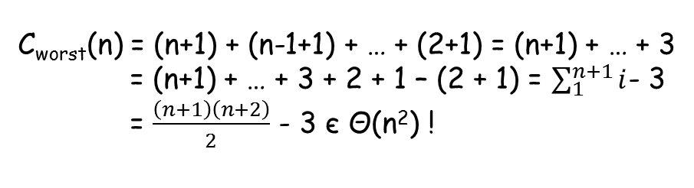

Div. & Conqr.: Quicksort (contd.)
T(n) = aT(n/b)+f(n), a ≥ 1, b > 1
If f(n) є n^{d} with d ≥ 0, then
ALGORITHM Quicksort(A[l..r])
if l < r
s <- Partition( A[l..r] )
Quicksort( A[l..s-1] )
Quicksort( A[s+1]..r )
Θ(n^{d}) if a < b^{d}
T(n) є
Θ(n^{d}lgn) if a = b^{d}
j
j
j
j
Θ($n^{\log_{b}{a}}$) if a > b^{d}
j
i
2 | 5 | 6 | 8 | 9
5+1=6
C_{best}(n) = 2C_{best}(n/2)+n for n > 1
C_{best}(1) = 0
i
j
5 | 6 | 8 | 9
4+1=5
i
j
Using Master Th^{m}, C_{best}(n) є Θ(nlgn)
6 | 8 | 9
3+1=4
What is the worst-case ?
j
i
8 | 9
2+1=3
C_{worst}(n) = (n+1) + (n-1+1) + … + (2+1) = (n+1) + … + 3
= (n+1) + … + 3 + 2 + 1 – (2 + 1) = $\sum_{1}^{n+1}{i}$- 3
= $\frac{\left(n+1\right)\left(n+2\right)}{2}$ - 3 є Θ(n²) !
So, Quicksort’s fate
depends on its average-case!

Slide 27
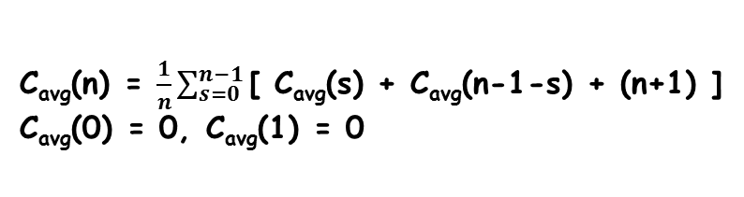
Div. & Conqr.: Quicksort (contd.)
Let us sketch the outline of average-case analysis…
ALGORITHM Quicksort(A[l..r])
if l < r
s <- Partition( A[l..r] )
Quicksort( A[l..s-1] )
Quicksort( A[s+1]..r )
C_{avg}(n) is the average number of key-comparisons
made by the Quicksort on a randomly ordered array
of size n
After n+1 comparisons, a partition can
happen in any position s (0 ≤ s ≤ n-1)
Let us assume that
partition split can
happen in each position s
with equal probability 1/n
After the partition, left part has s elements,
Right part has n-1-s elements
0
s
n-1
C_{avg}(n) = Expected[ C_{avg}(s) + C_{avg}(n-1-s) + (n+1) ]
p
Average over all possibilities
s elements
n-1-s elements
C_{avg}(n) = $\frac{1}{n}\sum_{s=0}^{n−1}{\text{[ }\text{Cavg}\text{(}\text{s}\text{) + }\text{Cavg}\text{(}\text{n}\text{−1−}\text{s}\text{) + (}\text{n}\text{+1) ]}}$
C_{avg}(0) = 0, C_{avg}(1) = 0
C_{avg}(n) ≈ 1.39nlgn

Slide 28
Div. & Conqr.: Quicksort (contd.)
Recall that for Quicksort, C_{best}(n) ≈ nlgn
So, C_{avg}(n) ≈ 1.39nlgn is not far from C_{best}(n)
Quicksort is usually faster than Mergesort or Heapsort on randomly ordered arrays of nontrivial sizes
Some possible improvements
Randomized quicksort: selects a random element as pivot
Median-of-three: selects median of left-most, middle, and right-most elements as pivot
Switching to insertion sort on very small subarrays, or not sorting small subarrays at all and finish the algorithm with insertion sort applied to the entire nearly sorted array
Modify partitioning: three-way partition
These improvements can speed up by 20% to 30%

Slide 29
Div. & Conqr.: Quicksort (contd.)
Weaknesses
Not stable
Requires a stack to store parameters of subarrays that are yet to be sorted, the stack can be made to be in O(lgn) but that is still worse than O(1) space efficiency of Heapsort
DONE with Quicksort!

Slide 30
Div. & Conq. : Multiplication of Large Integers
We want to efficiently multiply two very large numbers, say each has more than 100 decimal digits
How do we usually multiply 23 and 14?
23 = 2*10¹ + 3*10⁰, 14 = 1*10¹ + 4*10⁰
23*14 = (2*10¹ + 3*10⁰) * (1*10¹ + 4*10⁰)
23*14 = (2*1)10² + (2*4+3*1)10¹+(3*4)10⁰
How many multiplications?
4 = n²

Slide 31
Div. & Conq. : Multiplication of Large Integers
23*14 = (2*1)10² + (2*4+3*1)10¹+(3*4)10⁰
We can rewrite the middle term as:
(2*4+3*1) = (2+3)*(1+4) - 2*1 - 3*4
What has been gained?
We have reused 2*1 and 3*4 and now need
one less multiplication
If we have a pair of 2-digits numbers a and b
a = a₁a₀ and b = b₁b₀
we can write c = a*b = c₂10²+c₁10¹+c₀10⁰
c₂ = a₁*b₁
c₀ = a₀*b₀
c₁ = (a₁+a₀)*(b₁+b₀)-(c₂+c₀)

Slide 32
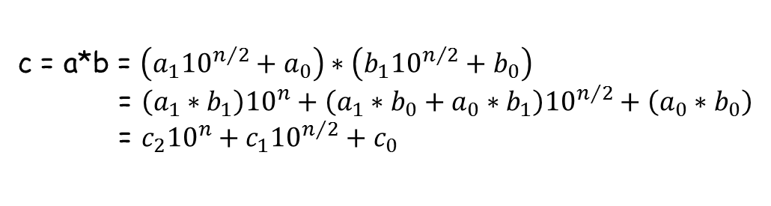
Div. & Conq. : Multiplication of Large Integers
If we have a pair of 2-digits numbers a and b
a = a₁a₀ and b = b₁b₀
we can write c = a*b = c₂10²+c₁10¹+c₀10⁰
a = 1234 = 1*10³+2*10²+3*10¹+4*10⁰
= (12)10²+(34)
c₂ = a₁*b₁
, c₀ = a₀*b₀
c₁ = (a₁+a₀)*(b₁+b₀)-(c₂+c₀)
If we have two n-digits numbers,
a and b (assume n is a power of 2)
(12)10²+(34) = (1*10¹+2*10⁰)10²+3*10¹+4*10⁰
Apply the same idea
recursively to get c_{2,} c₁, c₀
until n is so small that you can
you can directly multiply
a:
a₁
a₀
n/2 digits
b:
b₁
b₀
c = a*b = $\left(a_{1}{10}^{n/2}+a_{0}\right)∗\left(b_{1}{10}^{n/2}+b_{0}\right)$
= $\left(a_{1}∗b_{1}\right){10}^{n}+\left(a_{1}∗b_{0}+a_{0}∗b_{1}\right){10}^{n/2}+\left(a_{0}∗b_{0}\right)$
= $c_{2}{10}^{n}+c_{1}{10}^{n/2}+c_{0}$
We can write,
a = a₁10^{n/2} + a₀
Why?
b = b₁10^{n/2} + b₀
c₂ = a₁*b₁
c₀ = a₀*b₀
c₁ = (a₁+a₀)*(b₁+b₀)-(c₂+c₀)

Slide 33

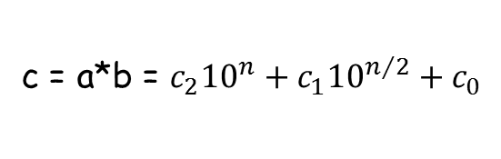
Div. & Conq. : Multiplication of Large Integers
c = a*b = $c_{2}{10}^{n}+c_{1}{10}^{n/2}+c_{0}$
Notice: a₁, a₀, b₁, b₀ all are n/2
digits numbers
5 additions
1 subtraction
c₂ = a₁*b₁
c₀ = a₀*b₀
So, computing a*b requires
three n/2-digits multiplications
c₁ = (a₁+a₀)*(b₁+b₀)-(c₂+c₀)
Recurrence for the number of
Multiplications is
M(n) = 3M(n/2) for n > 1
Assume n = 2^{m}
M(n) = 3M(n/2) = 3[ 3M(n/2²) ] = 3²M(n/2²)
M(1) = ?
M(n) = 3^{m}M(n/2^{m}) = ?
How many additions
And subtractions?
Let $3^{\log_{2}{n}}$ = x
$\log_{n}{3}\log_{2}{n}$ = $\log_{n}{x}$
$\log_{2}{3}$= $\log_{n}{x}$
x = $n^{\log_{2}{3}}$
# of add/sub,
A(n) = 3A(n/2)+cn for n > 1
A(1) = 0
M(n) = 3^{m} = 3^{lgn} = n^{lg3}
Why?
Using Master Th^{m},
A(n) є Θ(n^{lg3})
M(n) ≈ n^{1.585}

Slide 34
Div. & Conq. : Multiplication of Large Integers
People used to believe that multiplying two n-digits number has complexity Ω(n²)
In 1960, Russian mathematician Anatoly Karatsuba, gave this algorithm whose asymptotic complexity is Θ(n^{1.585})
A use of large number multiplication is in modern cryptography
It does not generally make sense to recurse all the way down to 1 bit: for most processors 16- or 32-bit multiplication is a single operation; so by this time, the numbers should be handed over to built-in procedure
Next we see how to multiply
Matrices efficiently…

Slide 35
Div. & Conq. : Strassen’s Matrix Multiplication
How do we multiply two 2×2 matrices ?
2
3 4
3 5
1 4
5 13
13 31
How many multiplications
and additions did we need?
=
8 mults and 4 adds
V. Strassen in 1969 found out, he can
do the above multiplication in the following
way:
m₁+m₄-m₅+m₇ m₃+m₅
m₂+m₄ m₁+m₃-m₂+m₆
a₀₀ a₀₁
a₁₀ a₁₁
b₀₀ b₀₁
b₁₀ b₁₁
c₀₀ c₀₁
c₁₀ c₁₁
=
=
m₁ = (a₀₀+a₁₁)*(b₀₀+b₁₁)
m₂ = (a₁₀+a₁₁)*b₀₀
m₃ = a₀₀*(b₀₁-b₁₁)
m₄ = a₁₁*(b₁₀-b₀₀)
m₅ = (a₀₀+a₀₁)*b₁₁
7 mults
18 adds/subs
m₆ = (a₁₀-a₀₀)*(b₀₀+b₀₁)
m₇ = (a₀₁-a₁₁)*(b₁₀+b₁₁)

Slide 36
Div. & Conq. : Strassen’s Matrix Multiplication
Let us see how we can apply Strassen’s idea for multiplying two n×n matrices
Let A and B be two n×n matrices where n is a power of 2
A₀₀ A₀₁
A₁₀ A₁₁
B₀₀ B₀₁
B₁₀ B₁₁
C₀₀ C₀₁
C₁₀ C₁₁
=
Each block is (n/2)×(n/2)
E.g., In Strassen’s
method,
M₁ = (A₀₀+A₁₁)*(B₀₀+B₁₁)
M₂ = (A₁₀+A₁₁)*B₀₀
etc.
You can treat blocks
as if they were numbers
to get the C = A*B

Slide 37
Div. & Conq. : Strassen’s Matrix Multiplication
ALGORITHM Strassen(A, B, n)
//Input: A and B are n×n matrices
//where n is a power of two
//Output: C = A*B
if n = 1
return C = A*B
else
Partition A = and B =
where the blocks A_{ij} and B_{ij} are (n/2)-by-(n/2)
M1 <- Strassen(A₀₀+A₁₁, B₀₀+B₁₁, n/2)
M2 <- Strassen(A₁₀+A₁₁, B₀₀, n/2)
M3 <- Strassen(A₀₀, B₀₁-B₁₁, n/2)
M4 <- Strassen(A₁₁, B₁₀-B₀₀, n/2)
M5 <- Strassen(A₀₀+A₀₁, B₁₁, n/2)
M6 <- Strassen(A₁₀-A₀₀, B₀₀+B₀₁, n/2)
M7 <- Strassen(A₀₁-A₁₁, B₁₀+B₁₁, n/2)
C₀₀ <- M1+M4-M5+M7
C₀₁ <- M3+M5
C₁₀ <- M2+M4
C₁₁ <- M1+M3-M2+M6
return C =
Recurrence for
# of multiplications is
M(n) = 7M(n/2) for n > 1
M(1) = ?
A₀₀ A₀₁
A₁₀ A₁₁
B₀₀ B₀₁
B₁₀ B₁₁
For n = 2^{m},
M(n) = 7M(n/2) = 7²M(n/2²)
M(n) = 7^{m} M(n/2^{m})
= 7^{m} = 7^{lgn}
= n^{lg7} ≈ n^{2.807}
For # of adds/subs,
A(n) = 7A(n/2)+18(n/2)² for n > 1
A(1) = 0
Using Master th^{m},
A(n) є Θ(n^{lg7}) better
than brute-force’s Θ(n³)
C₀₀ C₀₁
C₁₀ C₁₁
DONE WITH STRASSEN!

Slide 38
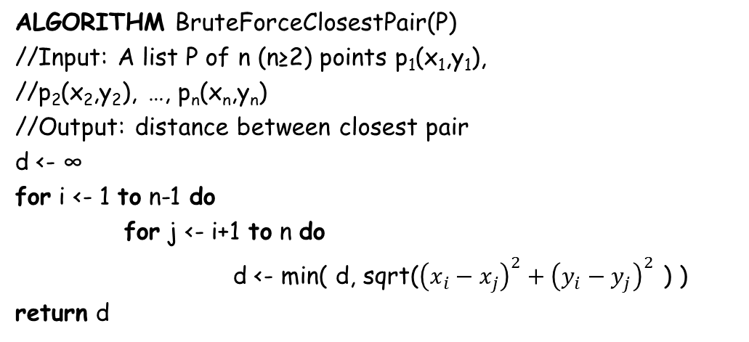

Div. & Conq.: Closest pair
Find the two closest points in a set of n points
ALGORITHM BruteForceClosestPair(P)
//Input: A list P of n (n≥2) points p₁(x₁,y₁),
//p₂(x₂,y₂), …, p_{n}(x_{n},y_{n})
//Output: distance between closest pair
d <- ∞
for i <- 1 to n-1 do
for j <- i+1 to n do
d <- min( d, sqrt(${\left(x_{i}−x_{j}\right)}^{2}+{\left(y_{i}−y_{j}\right)}^{2}$ ) )
return d
Traffic
Control:
detect two
vehicles
most likely
to collide
Idea: consider each pair of points and keep track of the
pair having the minimum distance
n
2
= $\frac{n(n−1)}{2}$
There are
pairs, so time-efficiency is in Θ(n²)

Slide 39
Div. & Conq.: Closest pair (contd.)
We shall apply “divide and conquer” technique to find a better solution
Any idea how to divide and then
conquer?
Solve right and left
portions recursively
and then combine
the partial solutions
x=m
Let P be the
set of points
sorted by
x-coordinates
let Q be the
same points sorted
by y-coordinates
How should we
combine?
d_{l}
d_{r}
d = min {d_{l}, d_{r}} ?
Does not work,
because one point
can be in left portion
and the other could be
in right portion having
distance < d between
them…
Left portion
Right portion

Slide 40
Div. & Conq.: Closest pair (contd.)
x=m
d = min{d_{l}, d_{r}}
We wish to find a pair
having distance < d
d_{l}
It is enough to consider
the points inside the symmetric
vertical strip of width 2d around
the separating line!
d_{r}
Why?
Because the distance
between any other pair
of points is at least d
Left portion
Right portion
But S can
contain all
points, right?
We shall scan through S, updating
the information about d_{min}, inititially
d_{min} = d using brute-force.
d
d
Let S be the list of points
inside the strip of width 2d
obtained from Q, meaning ?
Let p(x, y) be a point in S.
for a point p’(x’, y’) to have a
chance to be closer to p than d_{min},
p’ must “follow” p in S and the
difference bewteen their
y-coordinates must be less than d_{min}

Slide 41
Div. & Conq.: Closest pair (contd.)
x=m
Let p(x, y) is a point in S.
For a point p’(x’, y’) to have a
chance to be closer to p than d_{min},
p’ must “follow” p in S and
the difference bewteen their
y-coordinates must be less
than d_{min}
d_{l}
d_{r}
Why?
It seems, this rectangle
can contain many
points, may be all…
Geometrically,
p’ must be in
the following
rectangle
x=m
Left portion
Right portion
d
d
d_{min}
d
d
p
Now comes the crucial observation,
everything hinges on this one…
x=m
How many points can there
be in the d_{min}-by-2d rectangle?
d
d
One of these 8
being p, we need
to check 7 pairs
to find if any pair
has distance < d_{min}
d
My claim is “this”
is the most you can
put in the rectangle…

Slide 42
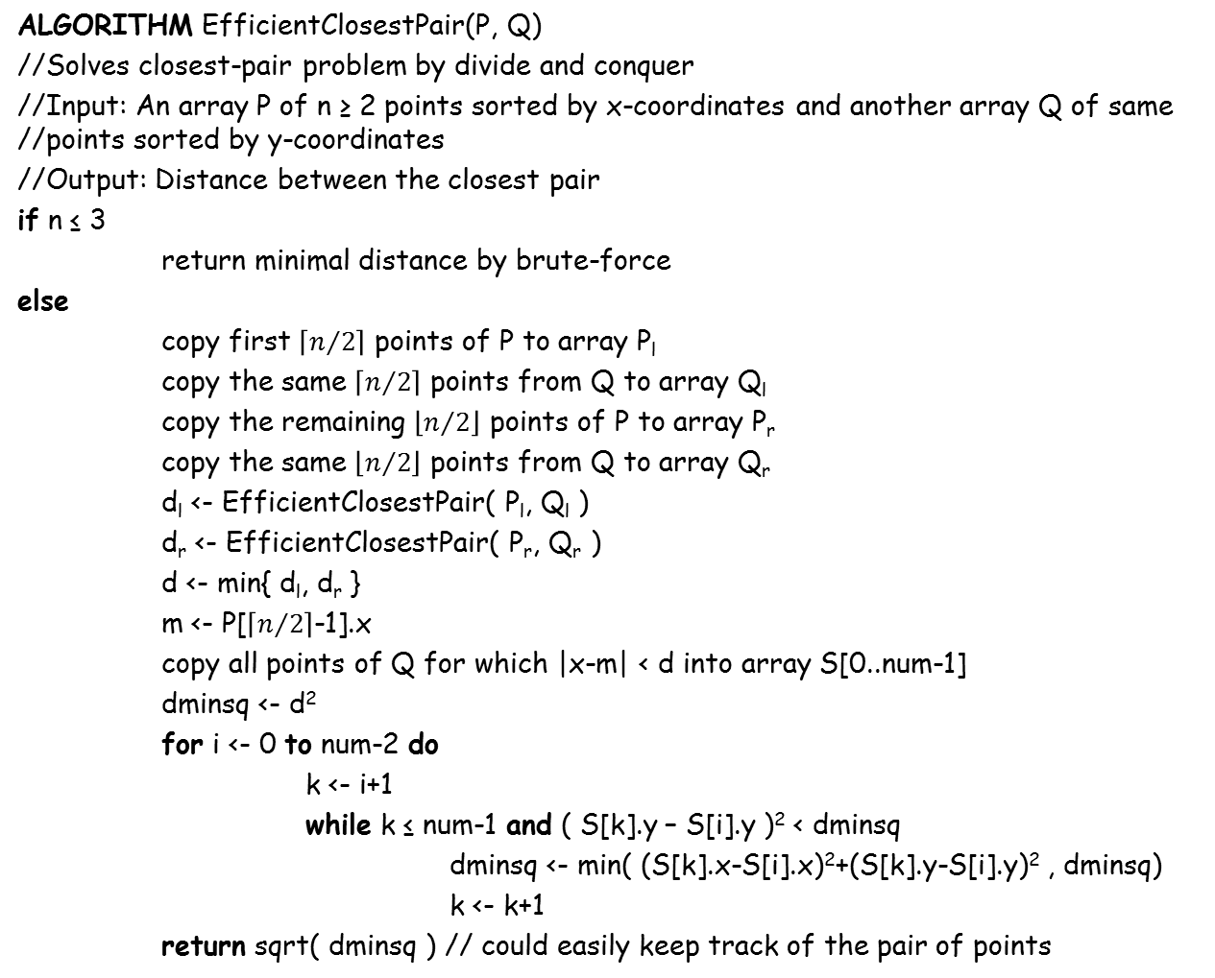
Div. & Conq.: Closest pair (contd.)
ALGORITHM EfficientClosestPair(P, Q)
//Solves closest-pair problem by divide and conquer
//Input: An array P of n ≥ 2 points sorted by x-coordinates and another array Q of same //points sorted by y-coordinates
//Output: Distance between the closest pair
if n ≤ 3
return minimal distance by brute-force
else
copy first $\left\lceil n/2\right\rceil$ points of P to array P_{l}
copy the same $\left\lceil n/2\right\rceil$ points from Q to array Q_{l}
copy the remaining $\left\lfloor n/2\right\rfloor$ points of P to array P_{r}
copy the same $\left\lfloor n/2\right\rfloor$ points from Q to array Q_{r}
d_{l} <- EfficientClosestPair( P_{l}, Q_{l} )
d_{r} <- EfficientClosestPair( P_{r}, Q_{r} )
d <- min{ d_{l}, d_{r} }
m <- P[$\left\lceil n/2\right\rceil$-1].x
copy all points of Q for which |x-m| < d into array S[0..num-1]
dminsq <- d²
for i <- 0 to num-2 do
k <- i+1
while k ≤ num-1 and ( S[k].y – S[i].y )² < dminsq
dminsq <- min( (S[k].x-S[i].x)²+(S[k].y-S[i].y)² , dminsq)
k <- k+1
return sqrt( dminsq ) // could easily keep track of the pair of points
The algorithm spends linear time
in dividing and merging, so assuming
n = 2^{m}, we have the following
recurrence for runnning-time,
T(n) = 2T(n/2)+f(n) where f(n) є Θ(n)
Applying Master Theorem,
T(n) є Θ(nlgn)
Dividing line
Brute froce
Inside the
2*d width strip
Points in 2*d
width strip

Slide 43
Thank you…

